Slide 1
Applying SAT-solvers to other problems

Slide 2
SAT-solver
Given a problem in propositional logic, find a satisfying assignment.
The technology has gotten immensely powerful.
Practical problems with millions of variables and tens of millions of clauses.
Problems designed to be hard*: Problems with thousands of variables and tens of thousands of clauses.
These are mostly extensions of DPLL.
Enormous gap between what is known theoretically --- running time is O(1.4^{n}) -- and what works in practice. We don’t really understand why these work as well as they do.
* If I have time, I’ll talk about how you do this.

Slide 3
Significance
Therefore, for all kinds of problems, it often pays to translate the problem into propositional calculus and use a high-powered SAT-solver.
Applications:
Hardware and software verification (bug finding).
Network protocol design (e.g. proving cloud service secure).
Scheduling. Planning.
Genomics, other computational biology.
Combinatorial and constraint problems generally.
Recondite mathematical problems.

Slide 4
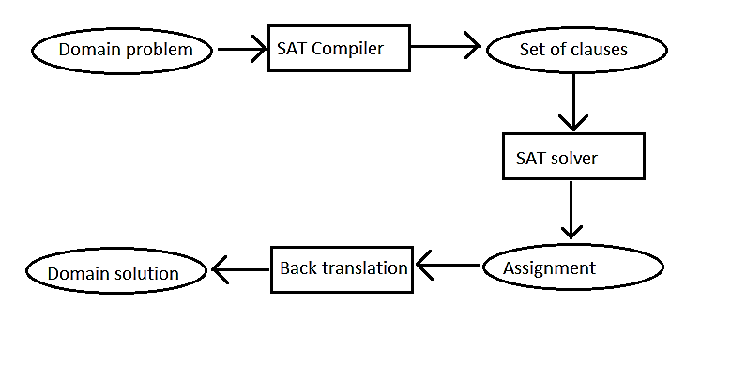
Overall architecture

Slide 5
What problems work well?
Promising candidates: Complex combinatorial problems
Less promising:
Problems involving numbers. Integers may be OK; floating point are bad.
Problems involving complex quantifiers (we will discuss when we talk about predicate calculus).
Adversary games.
Problems involving probabilities
Problems involving learning.
Problems involving infinite sets
However, sometimes with ingenuity, an unpromising problem can be handled.

Slide 6
No cookie cutter method for translating problems into SAT.
You have to think about it.
A solution has to be expressible as an assignment to propositional atoms.
You have to write the propositions in a way that:
For any solution to the problem, the corresponding assignment to the atoms satisfies all the propositions.
Any assignment that satisfies all the propositions corresponds to a valid translation

Slide 7
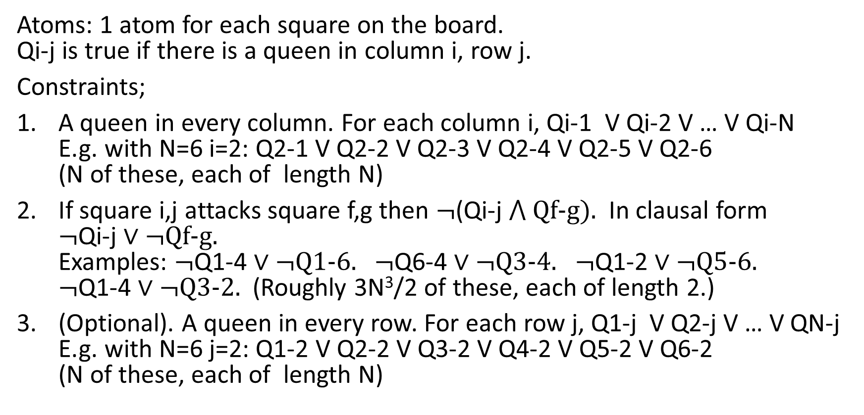
Translating N-Queens to SAT
Atoms: 1 atom for each square on the board. Qi-j is true if there is a queen in column i, row j.
Constraints;
A queen in every column. For each column i, Qi-1 V Qi-2 V … V Qi-N E.g. with N=6 i=2: Q2-1 V Q2-2 V Q2-3 V Q2-4 V Q2-5 V Q2-6 (N of these, each of length N)
If square i,j attacks square f,g then $¬$(Qi-j ⋀ Qf-g). In clausal form $¬$Qi-j ∨ $¬$Qf-g. Examples: $¬$Q1-4 ∨ $¬$Q1-6. $¬$Q6-4 ∨ $¬$Q3-4. $¬$Q1-2 ∨ $¬$Q5-6. $¬$Q1-4 ∨ $¬$Q3-2. (Roughly 3N³/2 of these, each of length 2.)
(Optional). A queen in every row. For each row j, Q1-j V Q2-j V … V QN-j E.g. with N=6 j=2: Q1-2 V Q2-2 V Q3-2 V Q4-2 V Q5-2 V Q6-2 (N of these, each of length N)

Slide 8
Translation process blows up problem
In our DFS encoding, a state is a data structure of size N. Now we have N² propositional atoms and something like 2N³ clauses.
In practice, often more apparent than real. Lots of singleton clauses in the course of running DPLL. The actual search space is not much larger.

Slide 9
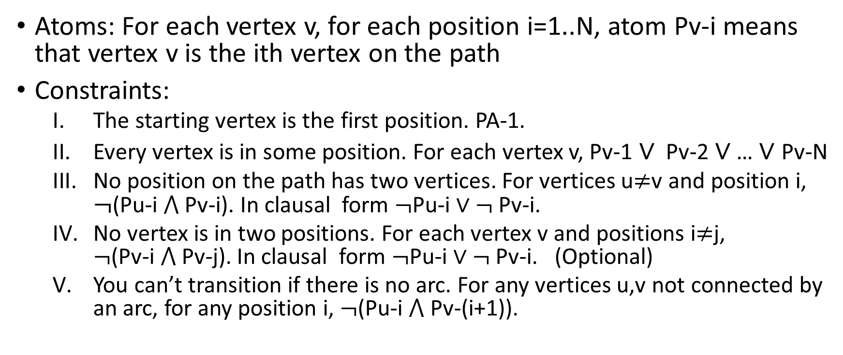
Translating Hamiltonian Path to SAT
Atoms: For each vertex v, for each position i=1..N, atom Pv-i means that vertex v is the ith vertex on the path
Constraints:
The starting vertex is the first position. PA-1.
Every vertex is in some position. For each vertex v, Pv-1 ∨ Pv-2 ∨ … ∨ Pv-N
No position on the path has two vertices. For vertices u≠v and position i, $¬$(Pu-i ⋀ Pv-i). In clausal form $¬$Pu-i ∨ $¬$Pv-i.
No vertex is in two positions. For each vertex v and positions i≠j, $¬$(Pv-i ⋀ Pv-j). In clausal form $¬$Pu-i ∨ $¬$Pv-i. (Optional)
You can’t transition if there is no arc. For any vertices u,v not connected by an arc, for any position i, $¬$(Pu-i ⋀ Pv-(i+1)).

Slide 10
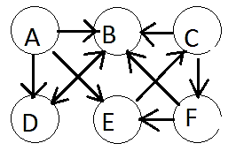
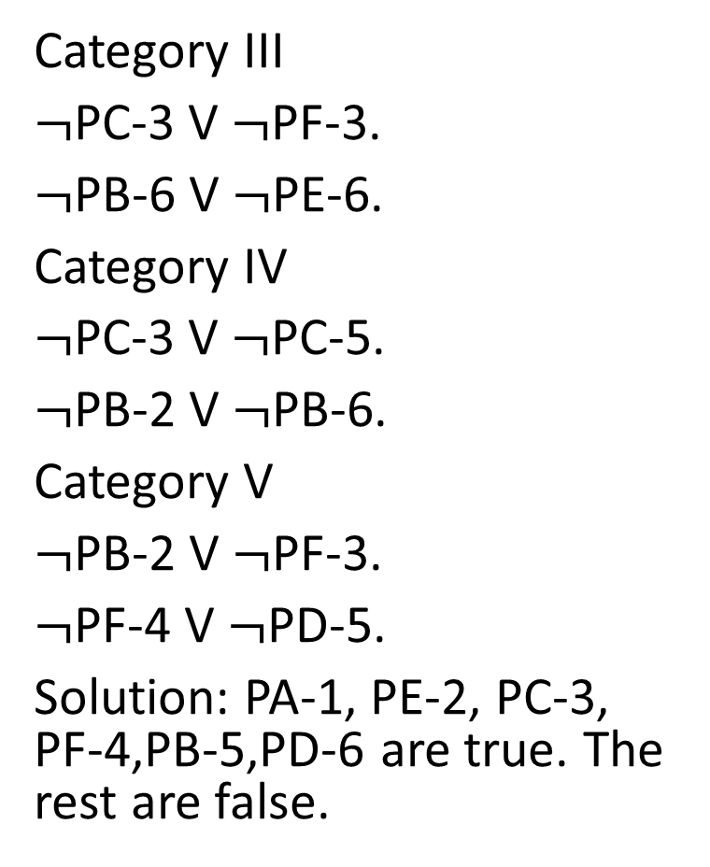
Examples in translating Hamiltonian path to SAT.
Category III
$¬$PC-3 V $¬$PF-3.
$¬$PB-6 V $¬$PE-6.
Category IV
$¬$PC-3 V $¬$PC-5.
$¬$PB-2 V $¬$PB-6.
Category V
$¬$PB-2 V $¬$PF-3.
$¬$PF-4 V $¬$PD-5.
Solution: PA-1, PE-2, PC-3, PF-4,PB-5,PD-6 are true. The rest are false.
Example constraints:
Category II.
PC-1 V PC-2 V PC-3 V PC-4 V PC-5 V PC-6
PB-1 V PB-2 V PB-3 V PB-4 V PB-5 V PB-6

Slide 11
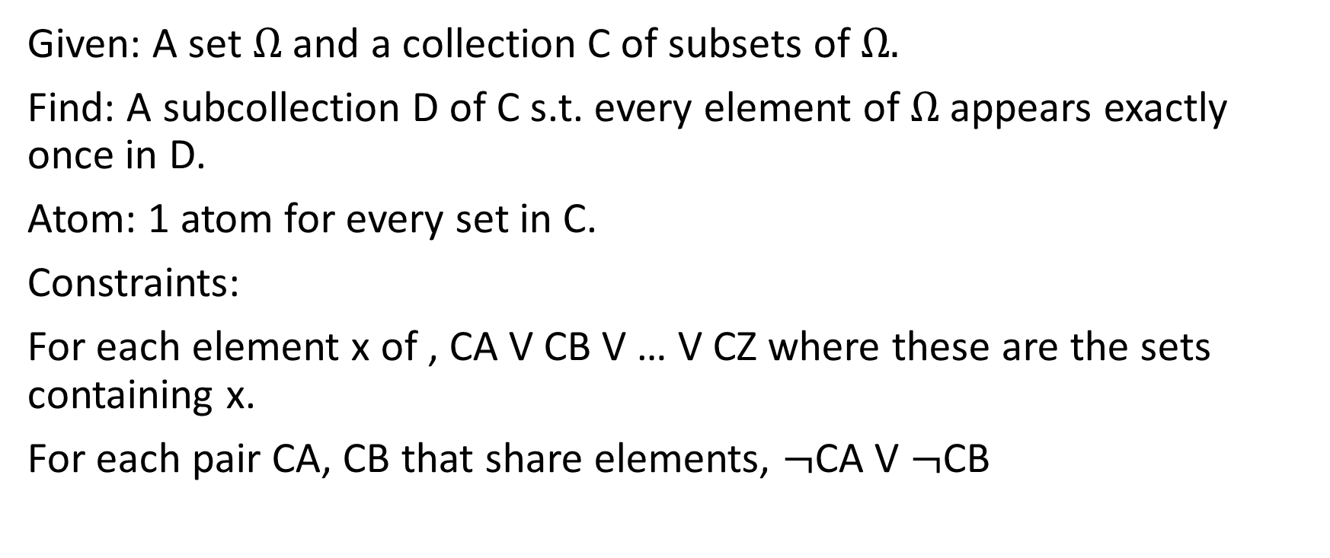
Translating Exact Set Cover to SAT
Given: A set Ω and a collection C of subsets of Ω.
Find: A subcollection D of C s.t. every element of Ω appears exactly once in D.
Atom: 1 atom for every set in C.
Constraints:
For each element x of , CA V CB V … V CZ where these are the sets containing x.
For each pair CA, CB that share elements, $¬$CA V $¬$CB

Slide 12
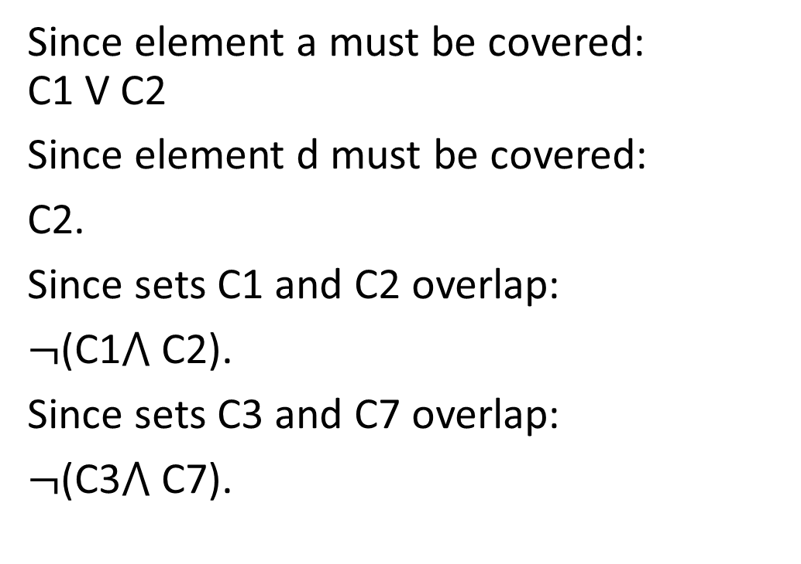
State space: Exact set cover
Example: Ω = {a,b,c,d,e,f,g,h}
C1={a,b,g}.
C2={a,c,d}.
C3={b,e}.
C4={c,h}.
C5={b,f,h}.
C6={c,f,h}.
C7={e,g}
Since element a must be covered: C1 V C2
Since element d must be covered:
C2.
Since sets C1 and C2 overlap:
$¬$(C1⋀ C2).
Since sets C3 and C7 overlap:
$¬$(C3⋀ C7).

Slide 13
Aren’t you throwing out knowledge about problem specifics?
that would allow you to design a solver tuned to the features of the particular problem?
Sometimes. (If an efficient algorithm is known, it’s probably a bad idea to give the problem to a SAT-solver.) However:
The SAT-solving technology sometimes can implicitly take advantage of these features by itself.
You can sometimes encode the problem in a way that takes advantage of the features.

Slide 14
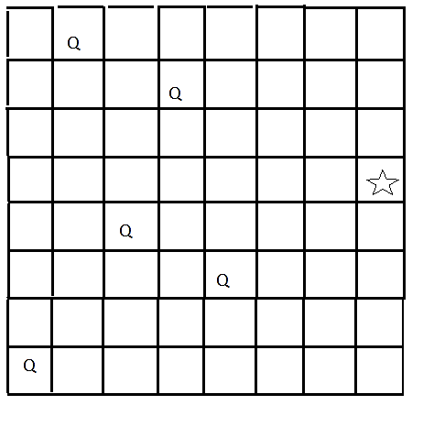
Potential advantages
Powerful technology for SAT.
The SAT version may enable you to combine inferences of different kinds in a way that can be hard to engineer in a domain-specific setting. E.g. in N-queens you can easily add the constraint that there is one queen in every row as well as in every column. That may constrain search faster e.g.

Slide 15
Potential advantages
Easy (sometimes) to construct variants of a problem, just by adding more constraints or changing constraints.

Slide 16
Programming Assignment 2

Slide 17
How to make up hard 3-SAT problems
Fix k = the number of atoms = say k=1000.
Fix n = the number of clauses – say n=3000.
Make up n random clauses all of length 3.
Pick 3 atoms at random for the clause
Make them positive or negative at random
Run a SAT solver. Record (a) whether there is a solution; (b) how long it takes to run.
Do this a bunch of times, so you get a random sample for this value of k and n.
Now, fix k and let n vary e.g. n=500, 1000,1500, … 10000

Slide 18
How to make up hard 3-SAT problems (cntd.)
When the number of clauses is very small, (e.g. the number of clauses is less than the number of atoms) there are almost always lots of solutions. The problem is underconstrained. In fact, rather than backtrack, you can just do random guesses.
When the number of clauses is very large, then there is very rarely a solution. The problem is almost always overconstrained.
You might think that the fraction of problems of size n that have a solution should decrease gradually.
You would be wrong. There is a very sharp drop. If n < about 4.3k then the clauses almost always have a solution; if n > 4.3k the clauses almost never have a solution. The larger you choose k, the sharper the transition.
And the hardest problems are right at the phase transition.

Slide 19
